Slide 1

AWS Systems Manager and DSC
Nana Lakshmanan
Dev Manager, AWS
Notes:
This is the slide shown before the presentation starts. When you are ready to go, tell the video operator to start the recording, and click to the next slide.

Slide 2
5
Video operator, did you start the recording?
Notes:
[REQUIRED SLIDE]
These slides are mandatory and help us with video post-processing. Please keep them as they are.

Slide 3
4
Notes:
[REQUIRED SLIDE]

Slide 4
3
Notes:
[REQUIRED SLIDE]

Slide 5
2
Notes:
[REQUIRED SLIDE]

Slide 6
1
Notes:
[REQUIRED SLIDE]

Slide 7
AWS Systems Manager and DSC
Nana Lakshmanan
Dev Manager, AWS
Notes:
This is your opening. Now the stage is yours!

Slide 8
This Session
Learn how to run PowerShell commands reliably at scale
Learn how to easily secure secrets
Learn to configure systems at scale with DSC, including
Growing from 1 to N instances
Enforce configuration compliance on a schedule
Compliance reports
Handling multiple configurations at once
Acquiring Secrets and configuration data from Parameter Store
Enhanced reboot behavior
Fetching from public and private repos
Notes:
Please invest some time to reconsider your session: what is it that audience can get out of it? Try and be as precise as you can. If you are showing solutions, then focus on “how to”. If you present about a general technology, you’ll want to stick to “Be able to” or “Understand why/how”.

Slide 9
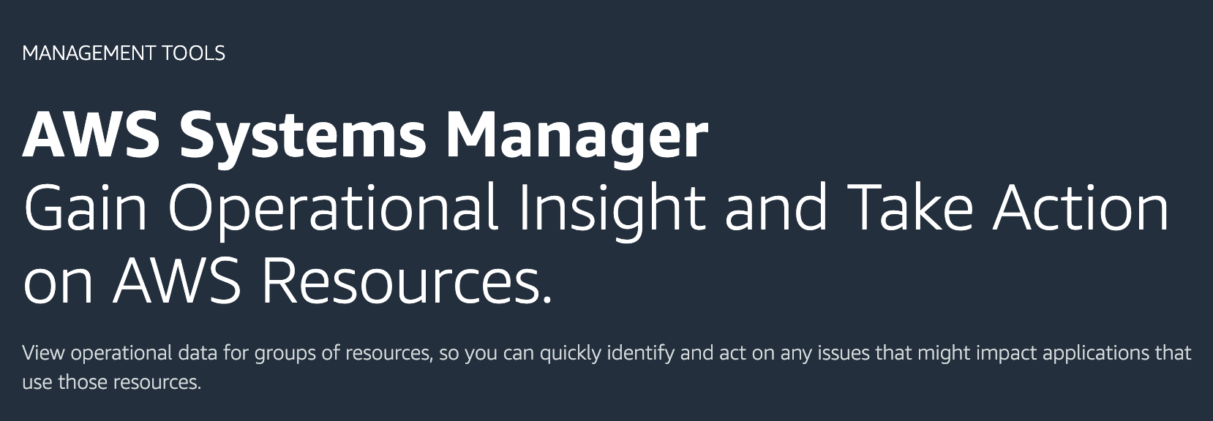
Systems Manager
The Operations Cockpit for any cloud at any scale

Slide 10
AWS Systems Manager Capabilities
Resource Groups
Patch Manager
State Manager
Run Command
Automation
Maintenance Window
Inventory
Parameter Store
Session Manager

Slide 11
AWS Systems Manager Capabilities
Resource Groups
Patch Manager
State Manager
Run Command
Automation
Maintenance Window
Inventory
Parameter Store
Session Manager

Slide 12
This Session
Learn how to run PowerShell commands reliably at scale
Learn how to easily secure secrets
Learn to configure systems at scale with DSC, including
Growing from 1 to N instances
Enforce configuration compliance on a schedule
Compliance reports
Handling multiple configurations at once
Acquiring Secrets and configuration data from Parameter Store
Enhanced reboot behavior
Fetching from public and private repos
Notes:
Please invest some time to reconsider your session: what is it that audience can get out of it? Try and be as precise as you can. If you are showing solutions, then focus on “how to”. If you present about a general technology, you’ll want to stick to “Be able to” or “Understand why/how”.

Slide 13
Run Command
Run any command remotely at scale
Supports both EC2 and on-prem instances
Has built in safety features - rate control and error threshold
Used for common administration tasks or ad-hoc configuration changes
Leveraged by other Systems Manager capabilities

Slide 14
Run Command – PowerShell script

Slide 15
State Manager
Maintains desired state and reports compliance at scale
Executes commands across instances
One time
On a schedule
Automatically associates newly launched instances based on tags
Safety features including rate control and error threshold
Notes:
- Desired state utility tool
- You can provide a configuration scripts and execute it on a schedule
State Manager also holds associations based on a tag, so if any new instance is launched within a tag, the association will be applied to that automatically. This is a very important feature that customers care about a lot
In case of Distributor, State Manager associations are used to always install the latest version of the software and to be able to pick the newly launched instances and install the software on it

Slide 16
Run PowerShell script on a schedule

Slide 17
This Session
Learn how to run PowerShell commands reliably at scale
Learn how to easily secure secrets
Learn to configure systems at scale with DSC, including
Growing from 1 to N instances
Enforce configuration compliance on a schedule
Compliance reports
Handling multiple configurations at once
Acquiring Secrets and configuration data from Parameter Store
Enhanced reboot behavior
Fetching from public and private repos
Notes:
Please invest some time to reconsider your session: what is it that audience can get out of it? Try and be as precise as you can. If you are showing solutions, then focus on “how to”. If you present about a general technology, you’ll want to stick to “Be able to” or “Understand why/how”.

Slide 18
Parameter Store
Secure and scalable parameters and secrets management service
Helps separate config from code
Provides hierarchy and version control
Control and audit access at granular levels
Supports change notifications and trigger Automation actions

Slide 19
Retrieve secrets from Parameter Store

Slide 20
This Session
Learn how to run PowerShell commands reliably at scale
Learn how to easily secure secrets
Learn to configure systems at scale with DSC, including
Growing from 1 to N instances
Enforce configuration compliance on a schedule
Compliance reports
Handling multiple configurations at once
Acquiring Secrets and configuration data from Parameter Store
Enhanced reboot behavior
Fetching from public and private repos
Notes:
Please invest some time to reconsider your session: what is it that audience can get out of it? Try and be as precise as you can. If you are showing solutions, then focus on “how to”. If you present about a general technology, you’ll want to stick to “Be able to” or “Understand why/how”.

Slide 21
Systems Manager and DSC
Systems Manager
DSC
Cloud native and built for scale
Safe and secure
Compliance reporting
Works for AWS, on-prem and other cloud
Language for authoring
Resource coverage
Standard MOF definition
☺

Slide 22
Configure instances using DSC

Slide 23
The Geeky Details

Slide 24
View DSC Compliance

Slide 25
Systems Manager DSC Enhancements
Desired State with security and at scale
Token substitutions at runtime
Centralized credential management
Reboot enhancements
Detailed reports saved as JSON in S3
Public and private module repositories

Slide 26
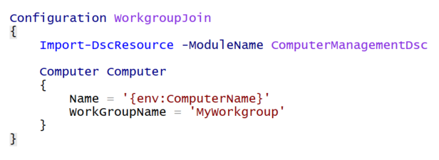
Tokens – Environment Variable
Retrieves a value from an environment variable

Slide 27
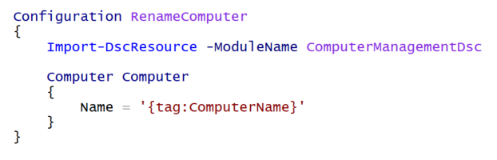
Tokens – EC2/Managed Instance Tags
Retrieves a value from the EC2 or Managed Instance Tag collection

Slide 28
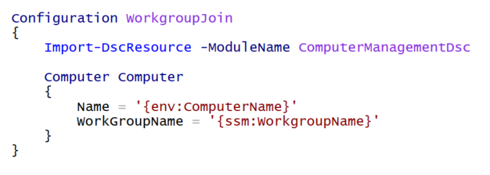
Tokens –Parameter Store
Retrieve a value from Parameter Store

Slide 29
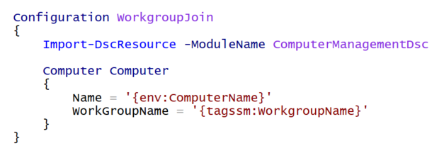
Tokens – Tag->SSM for one-box testing
Tries to retrieve a value from a Tag, and if the tag was not present, retrieves the value from Parameter Store.

Slide 30
Credential Support
Two sources supported:
SSM Parameter Store
AWS Secrets Manager
Credential must be stored in this JSON format: {
“Username”: “CONTOSO\MyUser”,
“Password”: “MyPassword”
}

Slide 31
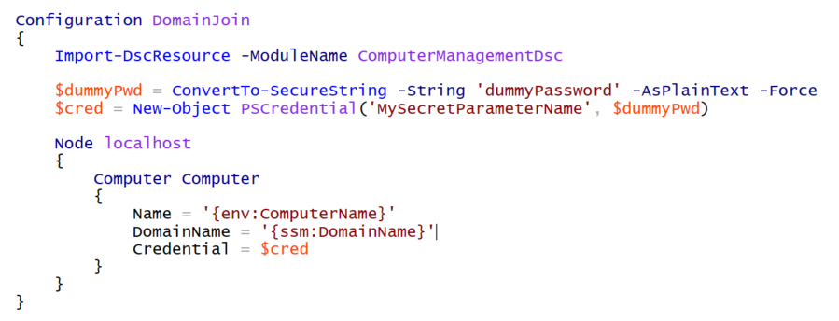
Credentials – Parameter Store

Slide 32
Reboot enhancements
Aggregate reboots to reduce apply time
Run a script before rebooting
Prevent a machine rebooting

Slide 33
Module Repositories
Downloads by default from PowerShell Gallery
Option to download from S3 bucket
Modules have to zipped as ModuleName_ModuleVersion.zip

Slide 34
Systems Manager DSC Enhancements

Slide 35
Summary
Run PowerShell commands reliably at scale
Easily secure secrets
Configure systems at scale with DSC, including
Growing from 1 to N instances
Handling multiple configurations at once
Acquiring Secrets and configuration data from Parameter Store
Enhanced reboot behavior
Enforce configuration compliance on a schedule
Build custom compliance reports
Fetching from public and private repos
Notes:
Please invest some time to reconsider your session: what is it that audience can get out of it? Try and be as precise as you can. If you are showing solutions, then focus on “how to”. If you present about a general technology, you’ll want to stick to “Be able to” or “Understand why/how”.

Slide 36
Notes:
[REQUIRED SLIDE]
Make sure you provide all materials that audience needs to reproduce your demos.
Either upload them as a PowerShell module to www.powershellgallery.com (preferred for reusable functions)
Or, upload them to our github repository (ask the girls at the info desk to provide you with access)
Or, upload them to your own github repository
Please make sure all materials are available by the time your presentation starts, or at minimum upload them right after your presentation

Slide 37
Notes:
[REQUIRED SLIDE]
If you sticked to your timing, you now have 15 min left for Q&A. If you missed your timing, you will have to leave the room when your slot is over. In this case, invite your audience to the coffee break and offer to cover questions there.
IN ANY CASE please point your audience to the conference app and the session voting. By the time the conference opens, the eventraft app *should* have the option to vote on sessions.
Please MAKE SURE you leave your room when your slot is over. The next speaker would like to set him/herself up and get everything up and running.

Slide 38
about_Speaker
Feel free to add information about yourself
You may advertise yourself or your company
Keep this slide at the end of your presentation
Do not use presentation time for your bio
Instead, your bio is published in the conference materials
Notes:
Do not EVER discuss this slide during your presentation. Please do not take presentation time to talk about yourself more than just a few introductory sentences. Instead, invite interested audience to the coffee break, and then talk about yourself, your job, your services, etc.
Use this slide to sum up your details. It will be part of the conference materials and recorded videos.

